Slide 1
Immunology Biol 465 Minot State University Spring 2020
MWF 9-9:50 am
Lab Tuesdays 9am-noon

Slide 2
Lecture 1 January 15, 2020
Course organization and information:
Website--http://msubiology.info/node/39
Syllabus
Typical lecture
General information—questions
Why understand immunology?...

Slide 3
Course website
http://msubiology.info/node/39
Students need to look for all info here!
Lectures will be posted here---grouped for each quiz.
Lots of resources!
Lab documents will be posted by Friday of each week for use on Tuesday.
Paper on 1918 influenza posted now

Slide 4
Typical lecture
Briefly recaps the concepts of the previous lecture
Provides announcements/changes
Summarizes new concepts
Uses many figures from the textbook!
Powerpoint is not necessarily the best teaching tool, but allows us to make steady progression each day. You should not rely on having “slides to review” for each exam. You must add detail to each lecture by reading and re-writing notes on you own.

Slide 5
Immunology
Requires a basic understanding of several areas of biology…

Slide 6
A. Cell Biology
For example:
Lymphocytes---leukocytes (white blood cells—wbc) called B-cells and T-cells are essential for many activities in an immune response.
B-cells squirt out soluble proteins known as antibodies.
T-cells (some types) can attack virus-infected cells of the host.
* I will assume you know the basics about cells, organelles, cell division….

Slide 7
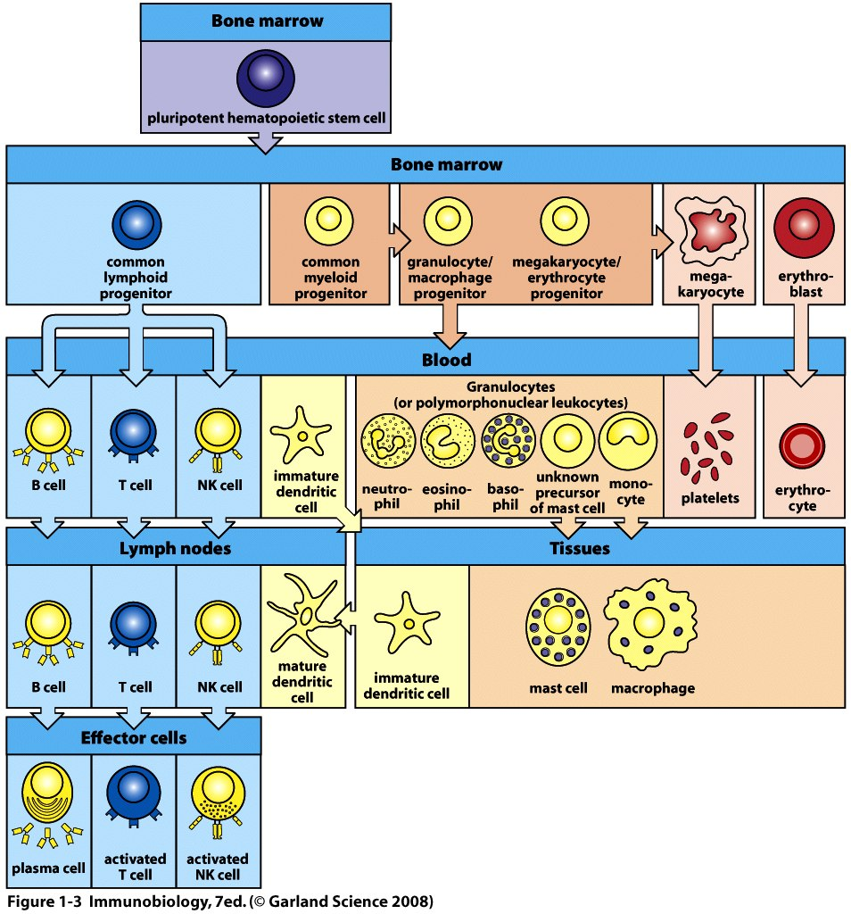
Lymphocytes
Become familiar with your textbook’s symbols!

Slide 8
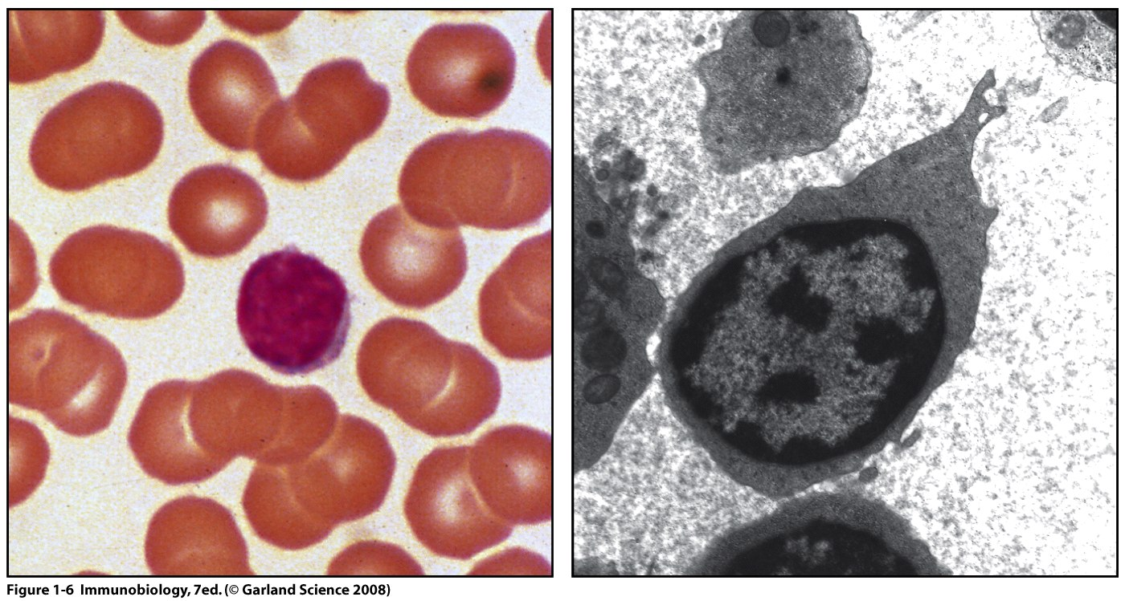
Lymphocytes

Slide 9
B. Microbiology
The immune system evolved to combat harmful microorganisms.
Harmful organisms are called pathogens.
Some bacteria, viruses, protozoa are considered pathogens
e. g. The influenza virus is a common, but dangerous virus

Slide 10
C. Molecular biology:
There are lots of specific molecules that are the key players in an immune response. Many are protein molecules.
examples
antibodies are protein complexes that bind to pathogens and neutralize their activities.
Protein receptors are embedded in cell membranes/ cell surfaces and bind other molecules. These receptors are critical in recognizing pathogens and in cell-to-cell communication.
cytokines are protein chemical regulators released and/or taken up by immune system cells.

Slide 11
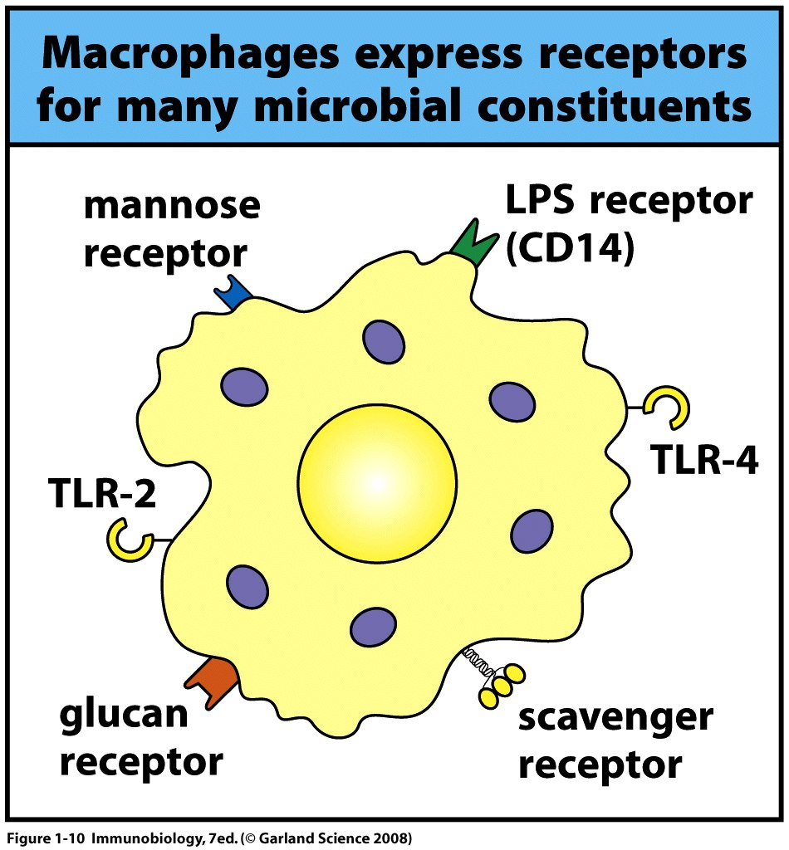

Slide 12
D. Genetics
The incredible efficiency of the immune system is due to many genes (which are the code for proteins), to careful gene expression regulation, and to evolution of genetic mechanisms to allow us to “see” many pathogens.
Example---we have lots of genes that encode antibodies (which are proteins). Each antibody gene ends up a bit different from any other so we make antibodies that can bind to many different pathogens.

Slide 13
You’ll need to know how proteins are made!
DNA RNA Protein
Sometimes called the central dogma of biology/molecular biology.
For example…We will walk through how gene expression (the making of RNA and protein) is regulated in leukocytes so that just the “right” proteins are made.

Slide 14
** Don’t allow yourself to get lost because you are unfamiliar with background concepts.
Dig deeper! Google, Wiki, read, read, read!
Check out or borrow textbooks
Set up office hours---even weekly meetings
Form a study group

Slide 15
Wait! Back up
What is immunology?
The study of the immune system and immune responses (normal immunity).
The study of malfunctions/diseases of the immune system.
The application/manipulation of immune system responses or activities in research and medicine

Slide 16
Immune response
The collection of biological activities which protect an organism against disease or death caused by a pathogen—invading organism.
We also have immune responses against cancer cells---which are not a “foreign” organism, but which show significant differences from “normal” cells.

Slide 17
A sample of pathogens
Type
Disease
Bacteria | Tetanus, pneumonia, Lyme disease, cholera, black plague, strep throat, ulcers, meningitis
Viruses | Flu (influenza), chicken pox, polio, mumps, measles, rubella, herpes, AIDS
Fungi | Ringworm, athletes’ foot, oral thrush, vaginal thrush
Parasites/worms | Malaria, sleeping sickness, Leishmainiasis, swimmers itch

Slide 18
When speaking about immune responses we often use the word host for the person, plant or animal that has been infected with the pathogen.
The host must distiguish its own cells and molecules (sometimes called self), from those of the pathogen (non-self).

Slide 19
The immune system has “layers” of defense.
There are mechanisms for recognition of pathogen and elimination of pathogen that occur sequentially.
Some pathogens receive multiple attacks using different activities of the immune system

Slide 20
2 basic types of immune responses
1. Innate immune response
Rapid (minutes to hours)
*Non-specific—but directed against pathogens
Requires no previous exposure to pathogen
Does not induce immunological memory (the ability the immune system to rapidly engage to kill a pathogen that has infected the host before).
Found in some form in nearly all plants and animals.

Slide 21
2. Adaptive immune response
Acquired after previous exposure to pathogen
Slow(weeks) to develop (at initial exposure)
Very specific—cells involved recognize a specific pathogen and even a very specific part of the pathogen, which we call an antigen.
Responses seen in jawed vertebrates (fairly recently evolved trait)

Slide 22
For Friday…
Review this lecture
Read the paper on the 1918 flu virus posted under documents.
Summarize each of the sections with one or 2 sentences. Look up terms you do not understand.
End your summary with a question regarding something you did not understand regarding the study.
Due Friday at the beginning of class

